Slide 1
Approach
The main approach was to convert this unsupervised problem to a supervised problem
Use a pre trained model (ResNet50) and feed its predictions to a Kmeans model so that it can cluster images that are similar. Use Elbow Method to determing the appropriate number of cluster needed for each individual class.
Use these clustered images to define which ones are the best for each and every category and which images are not the best
Now that we have labels for the Best View Image as well as the other images we can use this data to train our Image Classifier model to determine which image out of the 5 in a row is the best image as well as which class does it belong to.

Slide 2
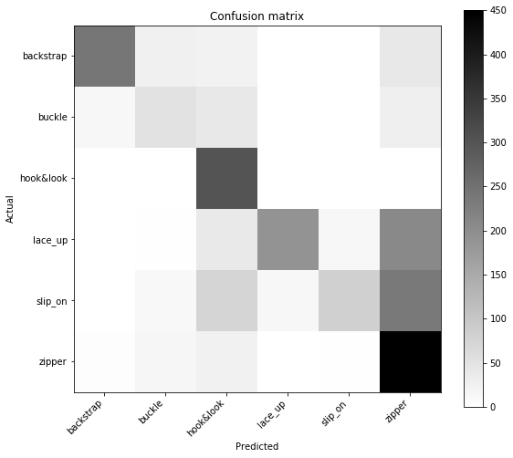
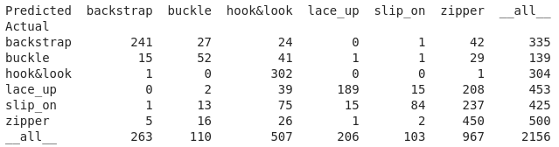
Train Accuracy: 86.45%
Validation Accuracy: 82.003%
Confusion Matrix ---->

Slide 3
Reason for choosing VGG19 over ResNet50 and DenseNet201 for Classification
Even though the latter models have more number of layers yet they were not able to outperform VGG19 in terms of Accuracy.
Training Accuracy of VGG19: 86.45%
Training Accuracy of ResNet50: 80.26%
Training Accuracy of DenseNet201: 81.4%

Slide 4
Insights about the Dataset Provided
Some of the labeled images were of the wrong class. Ex: Images labeled as zipper actually belonging to other classes, etc
Few of the images were also corrupted, hence the actual training data was reduced from 10731 images to 8994 images

Slide 5
List of Files Attached
fine_tune_shoes_multiclass.best.hdf5 - Model trained on Clustered Data to identify the class of an image
IPYNB as well as PDFs of Training, Clustering and Prediction Scripts
predict_class.py - Script to accept a CSV (should be of the original fomat as the training dataset, Format: python CSV_File.csv) and predict the class as well as the Best Image View for every given row of the CSV. The output CSV will have 2 additional columns namely predicted_class and best_view_image_link

Slide 6
References
Since this my was first time facing such a challenge my main point of reference was:
https://towardsdatascience.com/applying-deep-learning-for-fashion-e-commerce-7e9e28692172
Other References
https://keras.io/applications/
https://prateekvjoshi.com/2016/03/01/how-to-read-an-image-from-a-url-in-opencv-python/
https://chrisalbon.com/machine_learning/logistic_regression/handling_imbalanced_classes_in_logistic_regression/

